Slide 1
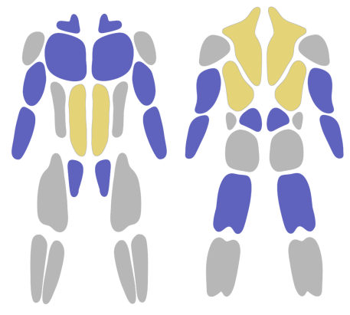



Home
Tag
Bench
# push # Monday
Personal Record
100 kg
:27 – 02 - 2001
(4 days ago)
Last exercise : 27 – 02 - 2001
Main : chest
Sub : forearm
Bench
# push # Monday
Personal Record
100 kg
:27 – 02 - 2001
(4 days ago)
Last exercise : 27 – 02 - 2001
Main : chest
Sub : forearm
Home
Status
Setting

Slide 2
Home
Tag
Bench
# push # Monday
Personal Record
100 kg
:27 – 02 - 2001
(4 days ago)
Last exercise : 27 – 02 - 2001
Main : chest
Sub : forearm
Bench
# push # Monday
Personal Record
100 kg
:27 – 02 - 2001
(4 days ago)
Last exercise : 27 – 02 - 2001
Main : chest
Sub : forearm
Home
Status
Setting

Slide 3
< Bench
PERSONAL RECORD
ONE REP MAX
(PREDICTED)
Set 2 | 12 kg * 5
15 kg
28-02-2024 (4 days ago)
TODAY
Set 1 | 10.0 kg * 5
Set 2 | 10.0 kg * 5
Set 3 | 10.0 kg * 5
28-02-2024 (4 days ago)
Set 1 | 10.0 kg * 5
Set 2 | 12.0 kg * 5
Set 3 | 10.0 kg * 5
28-02-2024 (4 days ago)
Set 1 | 10.0 kg * 5
Set 2 | 10.0 kg * 5
Set 3 | 10.0 kg * 5
28-02-2024 (4 days ago)
Set 1 | 10.0 kg * 5
Set 2 | 10.0 kg * 5
Set 3 | 10.0 kg * 5
Enter weight
Kg
ㅁ log as a warming up set
Enter reps
Reps
LOG

Slide 4
< Bench
PERSONAL RECORD
ONE REP MAX
(PREDICTED)
Set 2 | 12 kg * 5
15 kg
28-02-2024 (4 days ago)
TODAY
Set 1 | 10.0 kg * 5
Set 2 | 10.0 kg * 5
Set 3 | 10.0 kg * 5
28-02-2024 (4 days ago)
Set 1 | 10.0 kg * 5
Set 2 | 12.0 kg * 5
Set 3 | 10.0 kg * 5
28-02-2024 (4 days ago)
Set 1 | 10.0 kg * 5
Set 2 | 10.0 kg * 5
Set 3 | 10.0 kg * 5
28-02-2024 (4 days ago)
Set 1 | 10.0 kg * 5
Set 2 | 10.0 kg * 5
Set 3 | 10.0 kg * 5
Enter weight
Kg
ㅁ log as a warming up set
Enter reps
Reps
LOG

Slide 5


Status
Tag
ADD NEW EXERCISE
Bench
# push # Monday
Personal Record
100 kg
:27 – 02 - 2001
(4 days ago)
Last exercise : 27 – 02 - 2001
Main : chest
Sub : forearm
Bench
# push # Monday
Personal Record
100 kg
:27 – 02 - 2001
(4 days ago)
Last exercise : 27 – 02 - 2001
Main : chest
Sub : forearm
Bench
# push # Monday
Personal Record
100 kg
:27 – 02 - 2001
(4 days ago)
Last exercise : 27 – 02 - 2001
Main : chest
Sub : forearm
Bench
# push # Monday
Personal Record
100 kg
:27 – 02 - 2001
(4 days ago)
Last exercise : 27 – 02 - 2001
Main : chest
Sub : forearm
Bench
# push # Monday
Personal Record
100 kg
:27 – 02 - 2001
(4 days ago)
Last exercise : 27 – 02 - 2001
Main : chest
Sub : forearm
Home
Status
Setting

Slide 6
Status
Tag
ADD NEW EXERCISE
Bench
# push # Monday
Personal Record
100 kg
:27 – 02 - 2001
(4 days ago)
Last exercise : 27 – 02 - 2001
Main : chest
Sub : forearm
Bench
# push # Monday
Personal Record
100 kg
:27 – 02 - 2001
(4 days ago)
Last exercise : 27 – 02 - 2001
Main : chest
Sub : forearm
Bench
# push # Monday
Personal Record
100 kg
:27 – 02 - 2001
(4 days ago)
Last exercise : 27 – 02 - 2001
Main : chest
Sub : forearm
Bench
# push # Monday
Personal Record
100 kg
:27 – 02 - 2001
(4 days ago)
Last exercise : 27 – 02 - 2001
Main : chest
Sub : forearm
Bench
# push # Monday
Personal Record
100 kg
:27 – 02 - 2001
(4 days ago)
Last exercise : 27 – 02 - 2001
Main : chest
Sub : forearm
Home
Status
Setting

Slide 7

Setting
Personal Information
App Version
Send Feedback
Privacy Policy
Home
Status
Setting

Slide 8
Setting
Personal Information
App Version
Send Feedback
Privacy Policy
Home
Status
Setting

Slide 9
< Personal Information
Remove all the log data
Home
Status
Setting

Slide 10
< App Version
Current App version : 1.0.0
Home
Status
Setting

Slide 11
< Send Feedback
Home
Status
Setting

Slide 12
< Privacy Policy
Home
Status
Setting

